Slide 1
The Ecology of Aquatic Plants Workshop
Dr. Elizabeth Carroll
June 20, 2020
Lacawac Sanctuary
ecarroll2@holyfamily.edu

Slide 2
A Virtual Workshop
Module 1: The biology and life history of aquatic plants
Module 2: Benefits/Management
Module 3: Aquatic Plants – Basic Types
Module 4: Invasive aquatic plants in PA Citizen Science – Surveys!
Hands on IDs and sampling techniques
Break for Q/A
Resources

Slide 3
Module 1
The Biology and Life History of Aquatic Plants

Slide 4
Aquatic plants or macrophytes
Plants that have adapted to live in aquatic environments

Slide 5
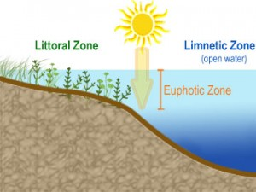
Comparing Aquatic plants and terrestrial plants.
Sunlight – perform photosynthesis and produce oxygen
Nutrients
Reproduction - Seeds/Flowers, fragmentation
No extensive roots

Slide 6
Module 2
Benefits of Aquatic Plants

Slide 7
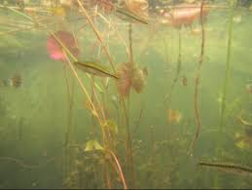
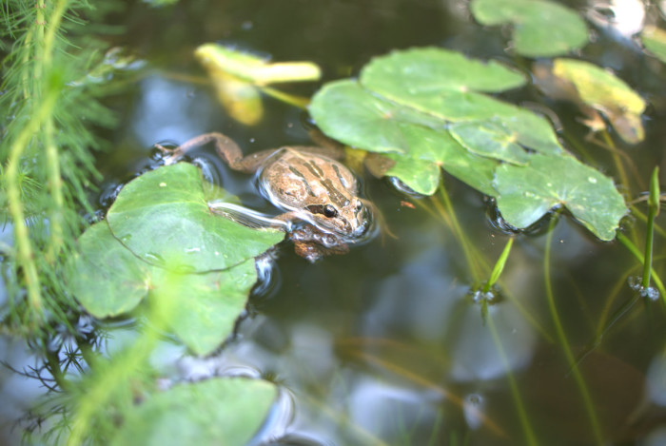
Benefits of Aquatic Plants
Provide habitat and protection for:
waterfowl
fish
frogs, salamanders and turtles
insects and other microscopic organisms
2. Important Nursery area for young fish, frogs, and salamanders
Cover from predators
Food supply
(RI Department of Environmental Management 2014)

Slide 8
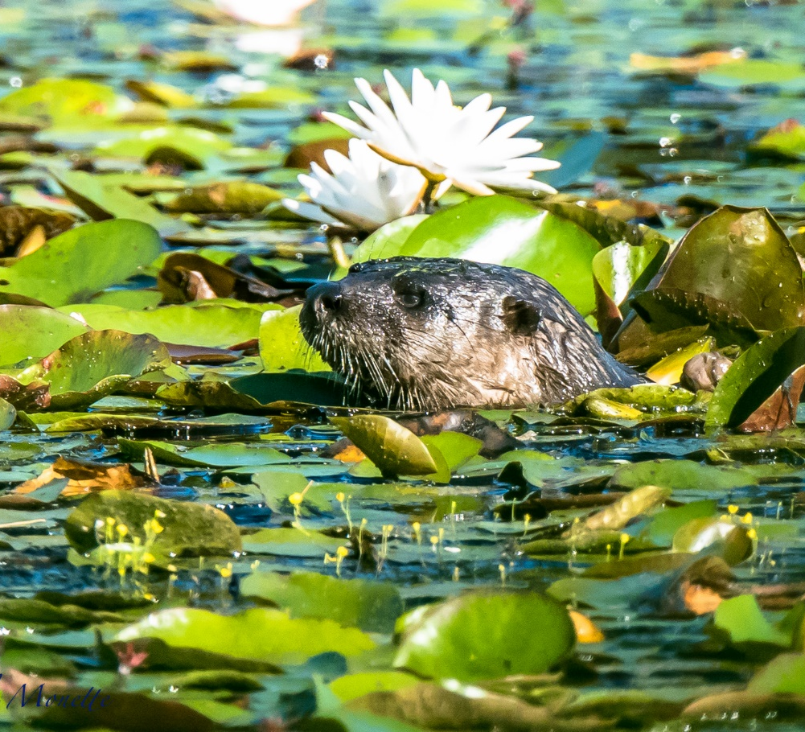
Benefits of Aquatic Plants
3. Act as food sources for:
Mammals (otter, beaver, muskrat, moose)
Birds (geese, ducks, songbirds)
Fish
Turtles
Invertebrates (such as insects)
4. Competes with algae
Compete for nutrients and sunlight
Limit algae growth
© Dale Monette

Slide 9
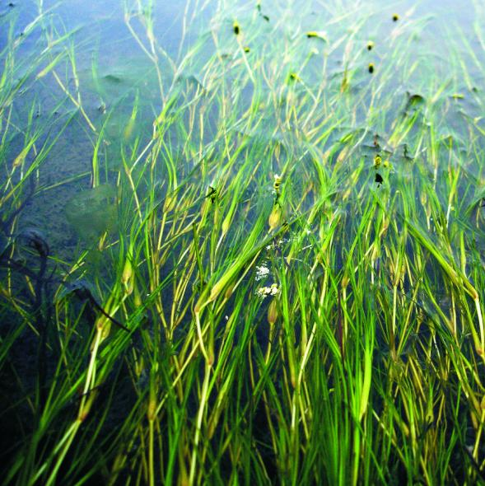
Benefits of macrophytes
Help recycle oxygen and carbon dioxide (CO2):
Take up CO2 and releasing oxygen in the water
Vital for fish survival
Maintaining a healthy pH level
Prevent shoreline erosion
Buffer destructive wave action that could lead to erosion.
Help improve water clarity
Aquatic plants may act as filters
trap particles
© Tim Carruthers

Slide 10
Module 3
Aquatic Plants: Basic Types

Slide 11
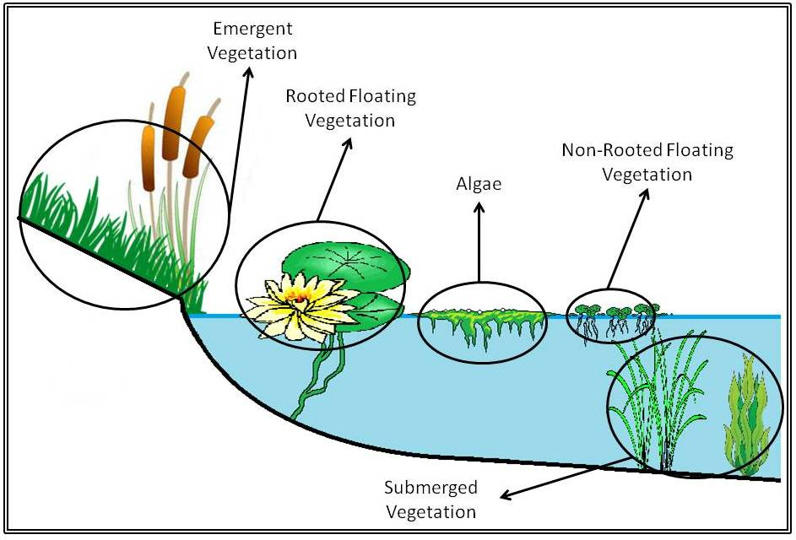

Slide 12
Emergent Aquatic Plants
Plants roots and basal portions grow beneath the surface of shallow water but leaves and stems are primarily in the air.
Examples include cattails, arrowhead, rushes, sedges, and many shoreline plants. Depths -0.5m - 1.5m
Pickerelweed, an emergent aquatic plant
Image from Maine.gov
Notes:
These include horsetail (Equisetum), cattails (Typha), bulrushes (Scirpus), sedges, rushes, pickerel weed (Pontedaria), arrowhead (Sagittaria) and many others.
Emergent plants often constitute the largest plant biomass in a wetland, however much of this is not directly available to fauna in the wetland foodchain.

Slide 13
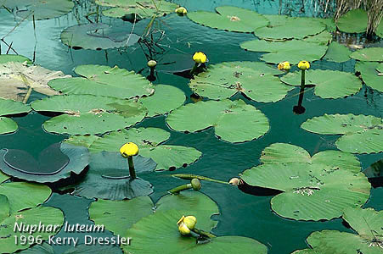
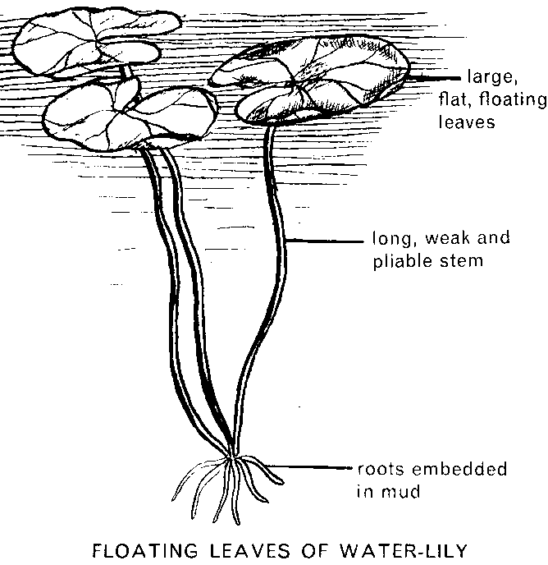
Rooted Floating-Leaf
Float on the water’s surface but their roots are anchored in the substrate.
Depths 0.5 m - 3 m
Notes:
These include pondweeds (Potomageton), water lilies (Nuphar, Nymphaea), water shield (Brasenia).
The leaves are connected to the bottom by petioles alone (water lilies) or through a combination of petioles and stems (pondweeds). Some have underwater leaves in addition to the floating leaves (some pondweeds).

Slide 14
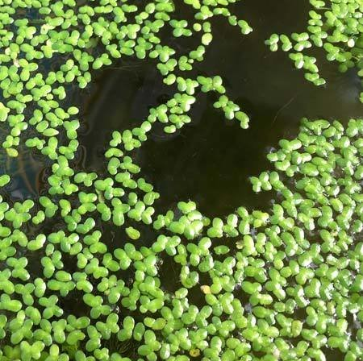
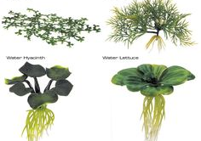
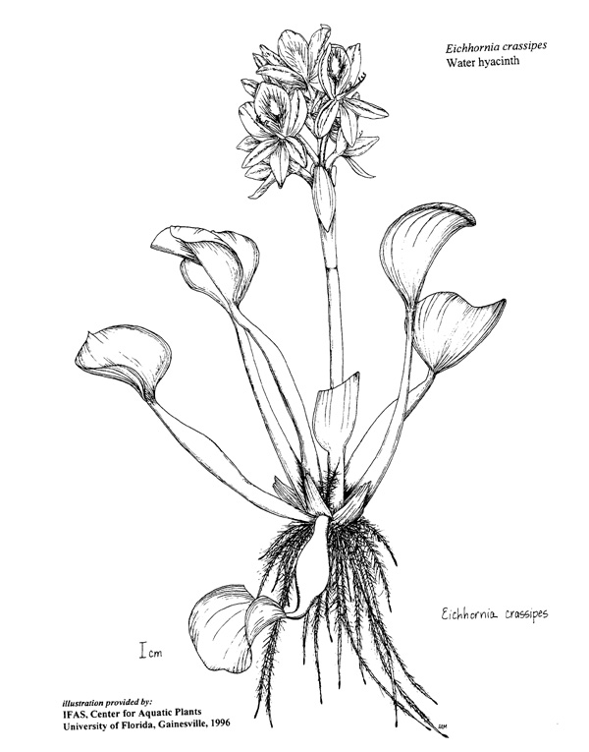
Free Floating
Float on water’s surface.
Roots, if present, hang free in the water.
Depths variable but restricted to nonturbulent, protected areas.
Ex. Duckweed, water hyacinth, water chestnut
Duckweed
Image from Univ. of Florida
Notes:
These include duckweeds (Lemna), water fern (Salvinia) water hyacinth (Eichhornia) water lettuce (Pistia) and water velvet (Azolla).
Free floating plants move with the current and can be blown by wind. Many reproduce vegetatively and some plants in this category are among the world’s worst weeds.

Slide 15
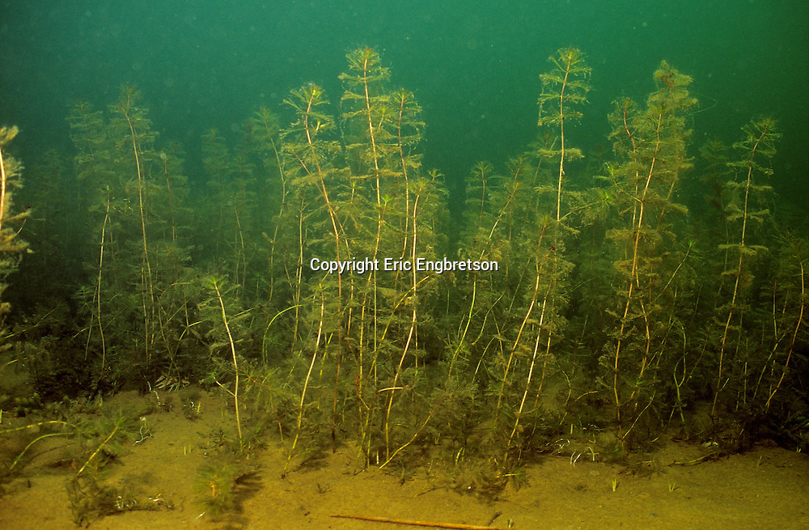
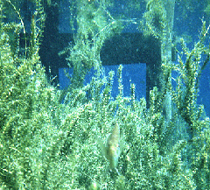
Submerged
Plants that spend their entire life cycle, with the possible exception of flowering, beneath the surface of the water. Depths to 10 m
Ex. Milfoil species, hydrilla, pondweeds
Eurasian watermilfoil
Hydrilla
Notes:
These include watermilfoil (Myriophyllum), Elodea, Hydrilla, many pondweeds (Potomagetons), wild celery (Vallisneria), bladderwort (Utricularia) and coontail (Ceratophyllum).
With very few exceptions, they are rooted.
This group has the greatest evolutionary departure from terrestrial plants.

Slide 16
Module 4
Aquatic Invasive Plants in the Poconos Region

Slide 17
Non-native/Invasive species in PA
Introduced species -- A species living outside of its natural geographic range. Can be deliberately or accidentally introduced or brought into the new ecosystem. Also called exotic, non-native, nuisance or invasive species.
Invasive -- Spreading or taking over. Invasive species often take over or dominate a habitat.
Native -- An animal or plant originating in a region or geographic range. For example, brook trout are native to Pennsylvania

Slide 18
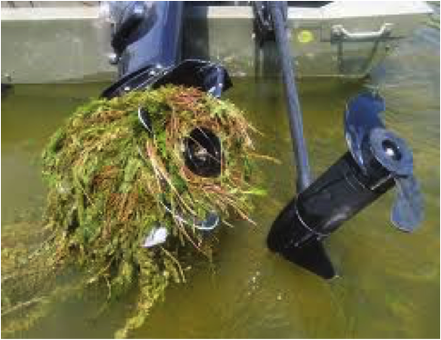
Non-native/Invasive species in PA
Impede recreation
Reduce aesthetic quality of lake
Tangle around outboard motors
Obstruct access to boat ramps/ boat lanes
Infest swimming areas
Snag fishing lines
Generate poor conditions for fish
Reduce visibility in the water
(RI Department of Environmental Management 2014)

Slide 19
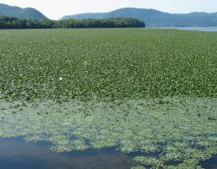
Non-native/Invasive species in PA
Limit ecological function of a lake
Out-compete beneficial native plants - Decrease biodiversity - Reduce water quality - Decompose slowly and reduce O2
Cause economic harm
Devalue waterfront property - Require substantial funds to manage - Diminish recreational tourism and revenues
© Princeton hydro

Slide 20
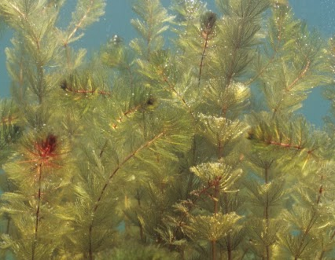
How can we address Aquatic Invasives?
PREVENT
ID
REPORT
© Engbretson Underwater Photography

Slide 21
Prevention

Slide 22
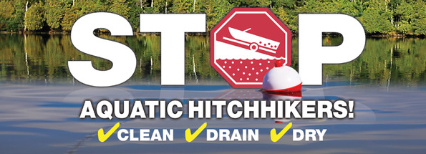
stopaquatichitchikers.org
Notes:
There are a few very simple steps anyone can follow when they are recreating or working in Pennsylvania’s waterways to prevent the introduction and spread of invasive species.
Stop Aquatic Hittchiker’s is a Community social marketing campaign empowers recreational users to stop the transport and spread using the Clean Drain Dry message.
Stopaquatichitchhikers.org

Slide 23
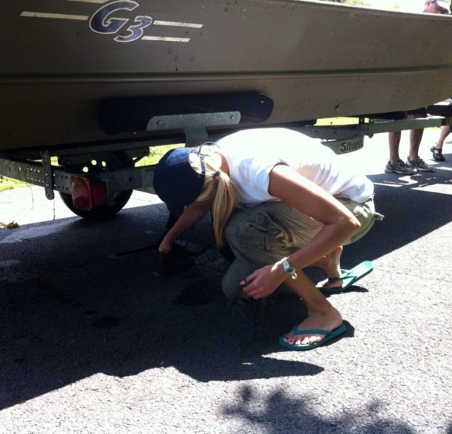
Inspect and clean any visible aquatic plants, animals, mud, or debris from all equipment before leaving water access
✔CLEAN
Pennsylvania Sea Grant
Notes:
Clean refers to completing a visual inspection of your boats and equipment any time you leave a waterbody.
This ensures you’re not carrying plant material, mud, organisms, or debris that could be harboring invasive species from one place to another.
Be sure to check watercraft, trailers, buckets, boots, and other equipment before leaving water access.
Stopaquatichitchhikers.org

Slide 24
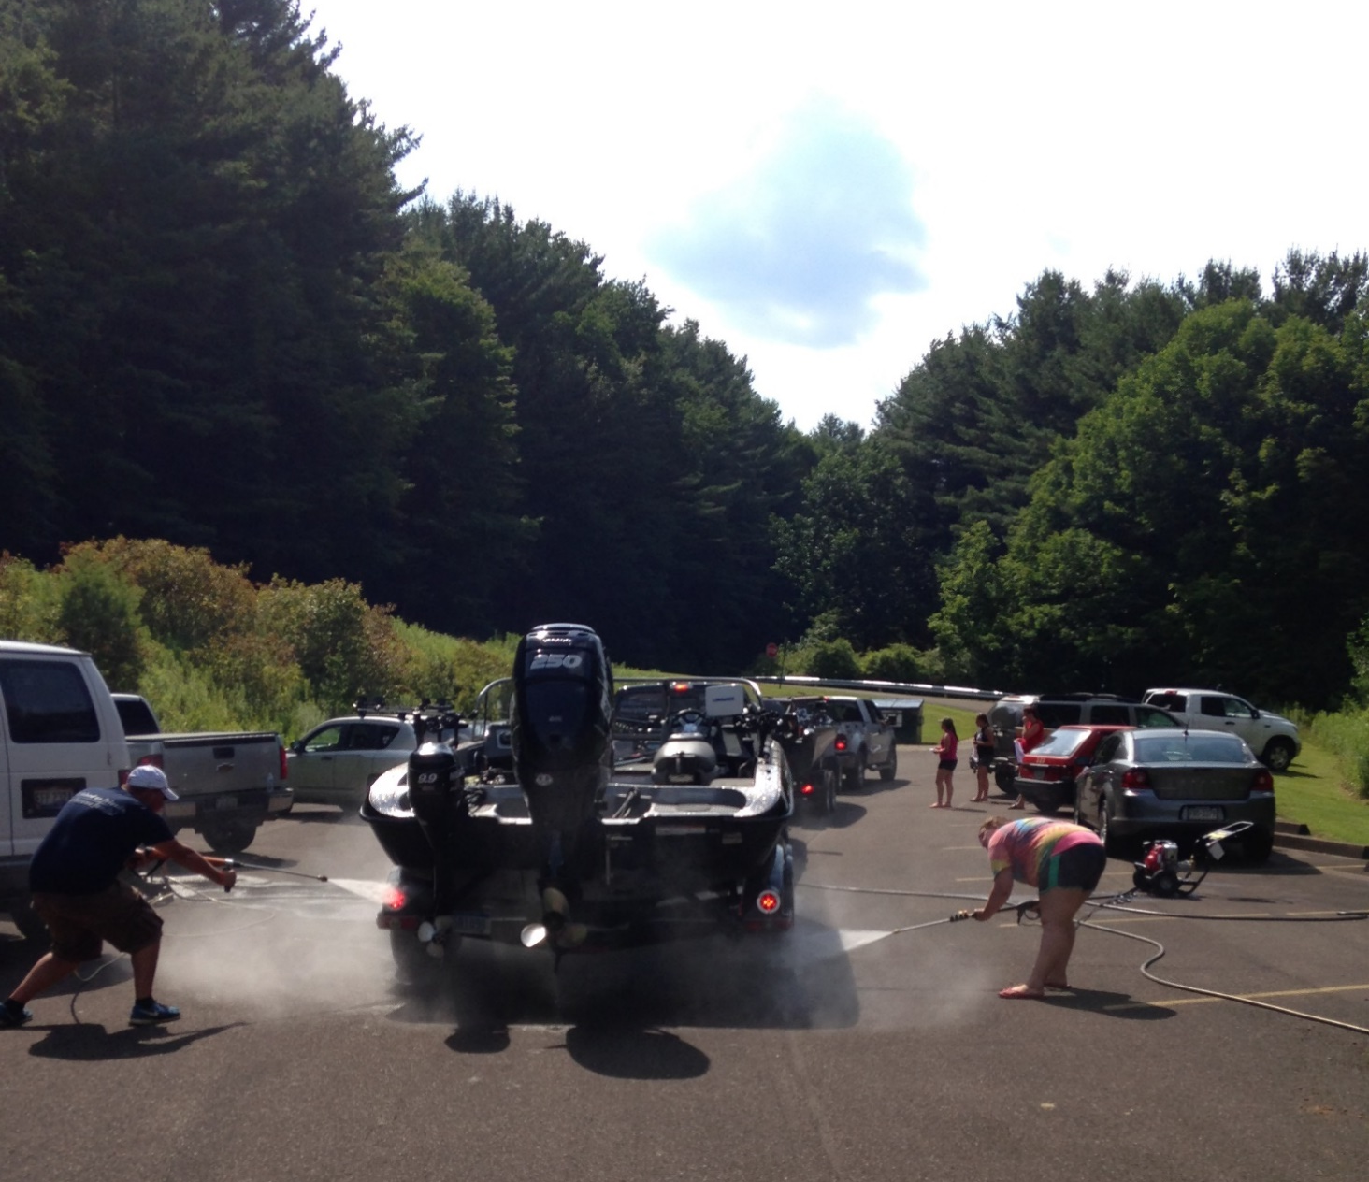
Pennsylvania Sea Grant
Notes:
In some locations, lakes are implementing volunteer launch stewards programs
Volunteers will spend time checking visitor before launching or leaving and provide educational opportunities for visiting boaters

Slide 25
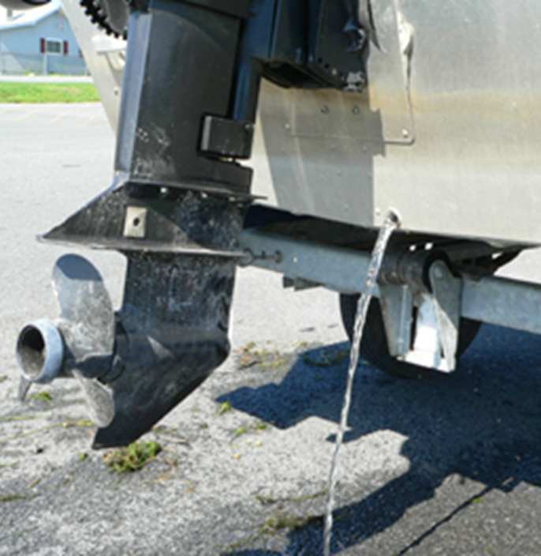
Drain water from bilge, livewell, motor and other water containing devices before leaving water access
✔DRAIN
New York DEC
Notes:
Draining means that you drain water from your boat’s bilge, livewell, motor and any other water containing devices before leaving water access
Microscopic species such as zebra mussel veligers, waterfleas, pathogens, or algae are so small they can’t be seen by the naked eye, and may be present in water being carried by boats and equipment
Draining before leaving the water access ensures you aren’t transporting microscopic organisms from place to place
Stopaquatichitchhikers.org

Slide 26
Dry for at least five days OR wipe with a towel before reuse
✔DRY
Wikimedia Commons
Notes:
Dry everything for at least five days
Or if you can’t wait 5 days before going to the next spot, wipe with a towel before reuse
Drying is very effective because these are aquatic organisms that will die once desiccated; however some species like zebra mussels have been known to survive clinging on to boat trailers for multiple days at a time before being introduced
Therefore, ensuring boats and equipment are completely dry is very important
Can also leave in direct sunlight for several hours until dry

Slide 27
Identification

Slide 28
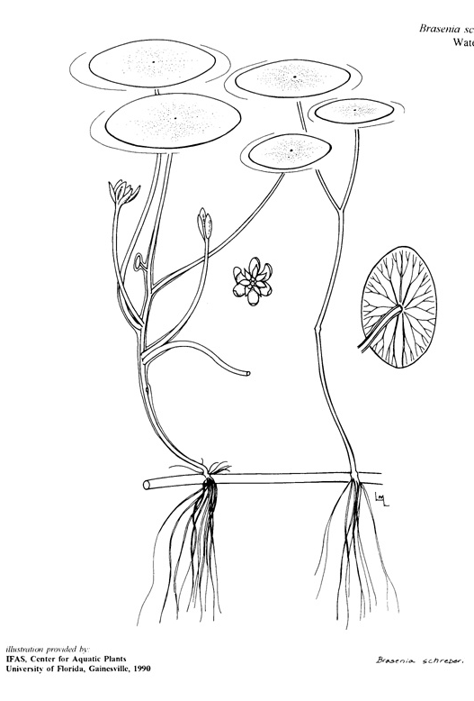
Identifying aquatic plants
Main structures to examine:
Leaves
Flowers
Fruit/Seeds
Stems/Roots

Slide 30
Six Key invasive species to watch for in our region
Eurasian watermilfoil
Variable-leaf milfoil
Water chestnut
Hydrilla
Curly Leaf Pondweed
Fanwort

Slide 31
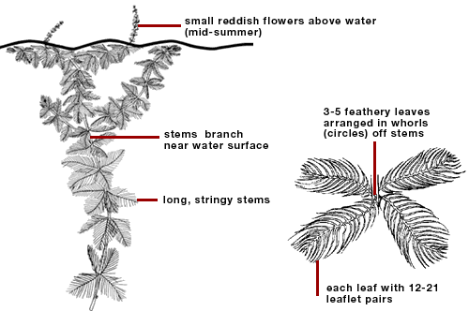
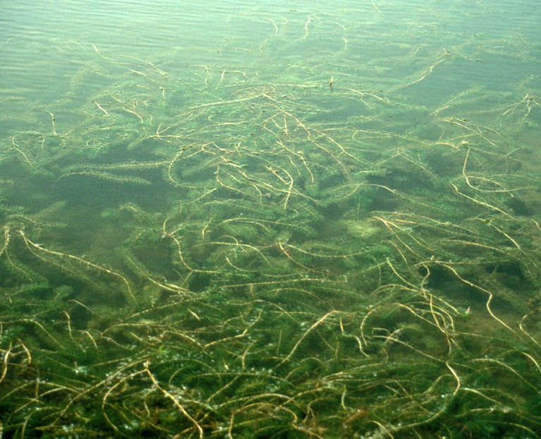
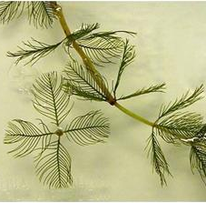
Eurasian watermilfoil
Grows in dense mats
Reproduces by fragmentation
Plant fragments break off and float via water currents, allowing it to disperse long distances and hitchhike on boats, boat trailers, motors, and fishing equipment.
Needs to be hand-pulled from the root for removal
Counting leaflets can provide helpful identification clues.
Many native look alikes

Slide 32
Variable-leaf milfoil
This extremely well-adapted plant can thrive in freshwater ponds, lakes, ditches, and other still or flowing aquatic systems, and even survives under ice.
Reproduction is primarily through vegetative fragments
hitchhike on boats, trailers, and fishing equipment.

Slide 33
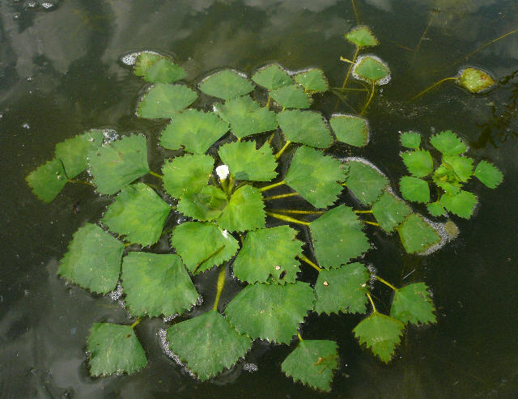
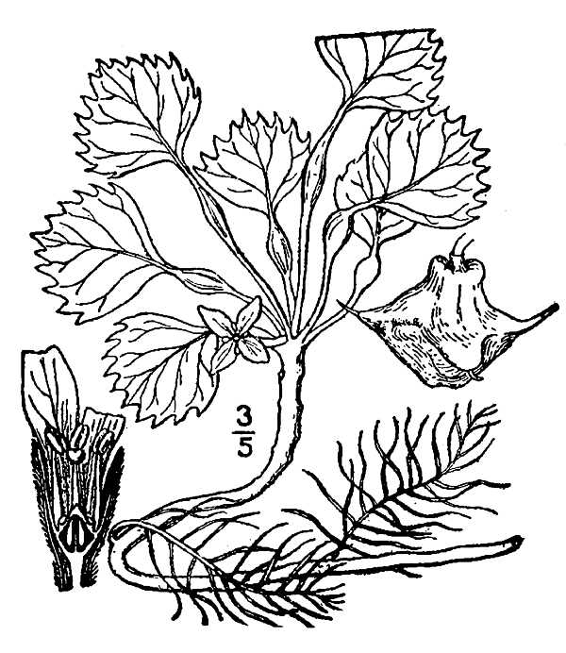
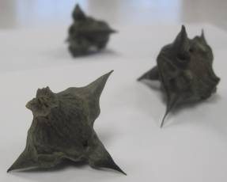
Water chestnut
© USGS
Thorny black nutlets
The nuts of water chestnut can remain viable in sediment for up to 12 years
Water chestnut can choke out waterbodies
Fast growing, floating aquatic plant
Leaves have two distinct forms: floating and submersed
Floating leaves are triangular and arranged in large floating rosettes
© USDA Plants

Slide 34
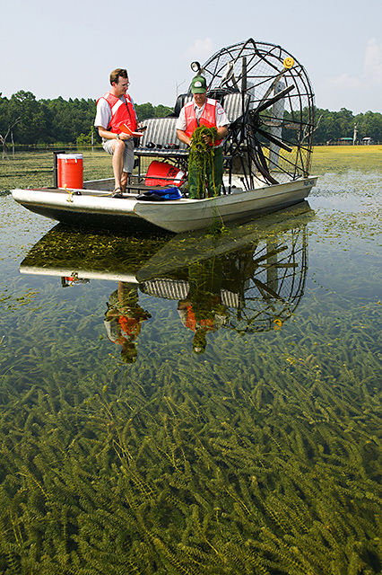
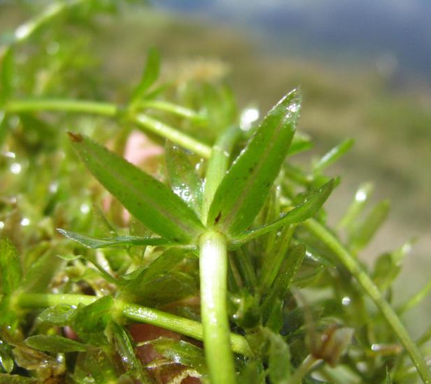
Hydrilla
Submerged aquatic perennial
Spreads very fast
Leaves are typically strap-like and pointed, with small sharp teeth on the edges
Reproduces via fragmentation
Produces tubers during late growing season
Whorls of 3-8 leaves
Small sharp teeth on leaf edges
Grows in water up to 12 feet deep
© PA Sea Grant
Stephen Ausmus, USDA, Encyclopedia of Life

Slide 35
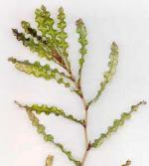
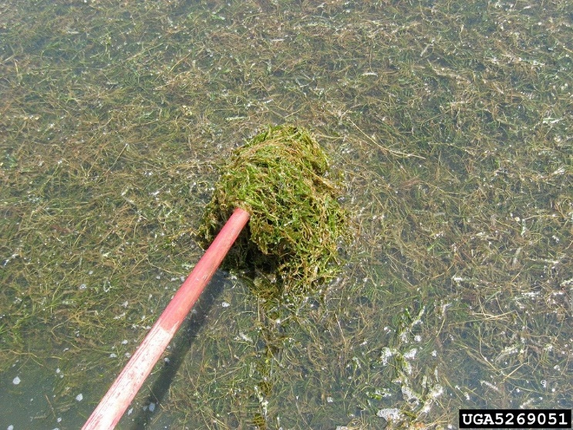
Curly-leaf pondweed
Has only submerged leaves.
Other pondweeds also lack the tiny but visible serrations along the edges of the leaves.
Curly-leaf pondweed prefers soft substrates and shallow water depths in alkaline and high nutrient waters.

Slide 36
Fanwort
Two types of leaves include submersed and floating.
Submersed leaves are delicate, fan-shaped, and usually green in color.
Finely divided and arranged in opposite pairs along the stem.
Floating leaves, which are not always present, are narrow, small oval to diamond in shape, and arranged in an alternating pattern.
Small white, pink, or purple flowers.

Slide 37
Reporting

Slide 38
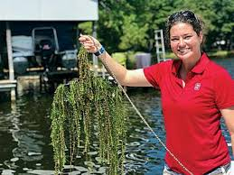
Citizen Science: Help us track aquatic plants and invasive species!

Slide 39
Lake Surveys
Boat the perimeter of your lake (you may wish to split up the lake over several days or divide the shoreline among volunteers)

Slide 40
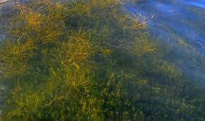
Lake Surveys
Select a day when the water is relatively calm and ripples are low – this will make it easier to spot submerged plants.

Slide 41
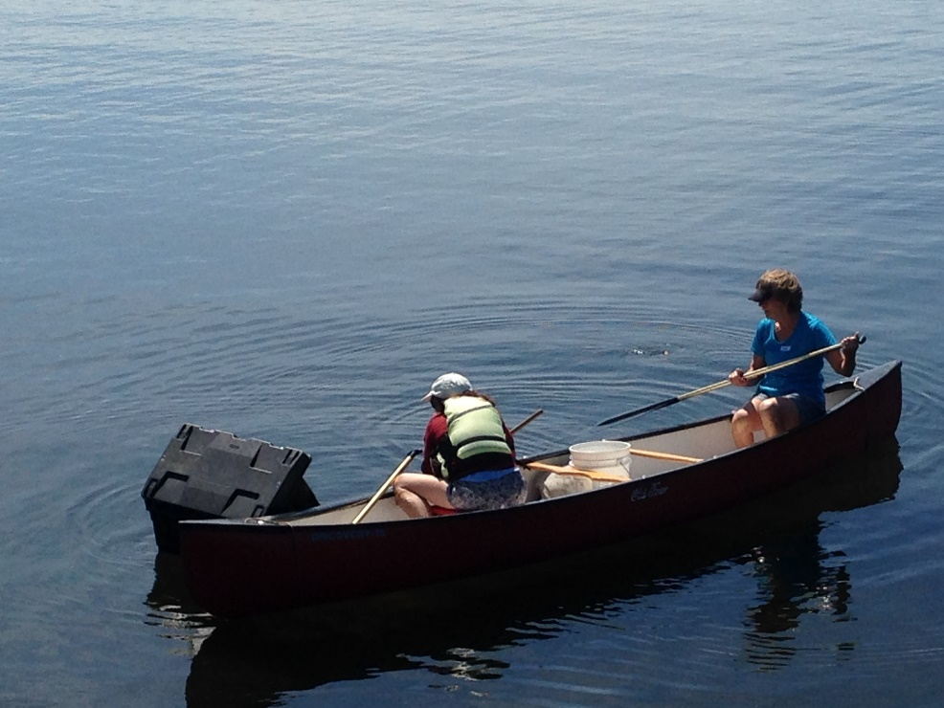
Lake Surveys
Slowly go around the perimeter of the lake and record the location of any submerged and emergent aquatic vegetation on a map of your lake.
Datasheet in binder
Rangeley Lakes Heritage Trust

Slide 42
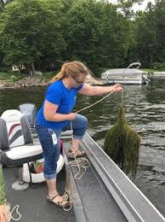
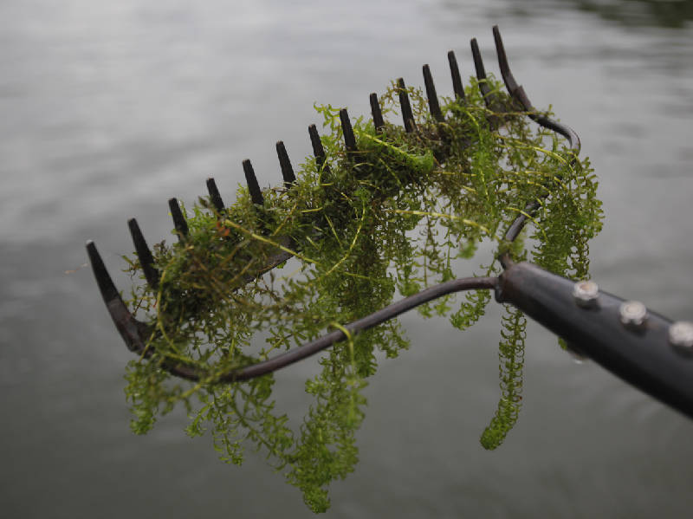
Optional tools: Rake toss

Slide 43
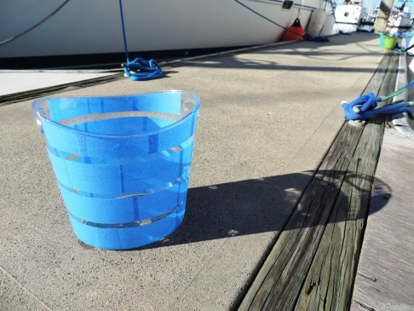
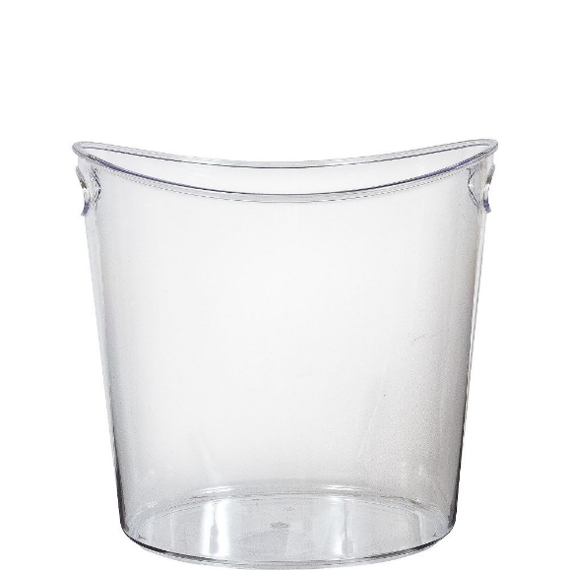
Optional tools: View bucket or view scope
Can be commercially purchased
DIY version: Acrylic “wine bucket”
https://www.partycity.com/clear-plastic-oval-ice-bucket-512273.html?cgid=tableware-serving-trays-platters-bowls
© Archipelago Sail

Slide 44
Lake Surveys
If you spot any potential invasive species notify PLEON of the location.
Mail in sample

Slide 45
Mail in samples
Wrap plant sample in a damp paper towel and place in a ziplock bag.
Mail to:
Elizabeth Carroll
Attn: Aquatic Plant Program
40 Bryant Avenue
Collingswood, NJ 08108

Slide 46
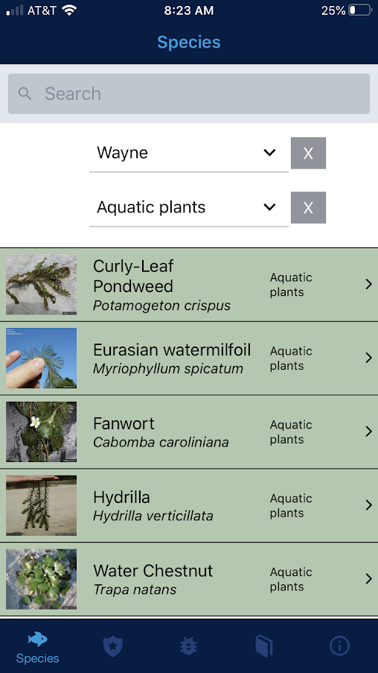
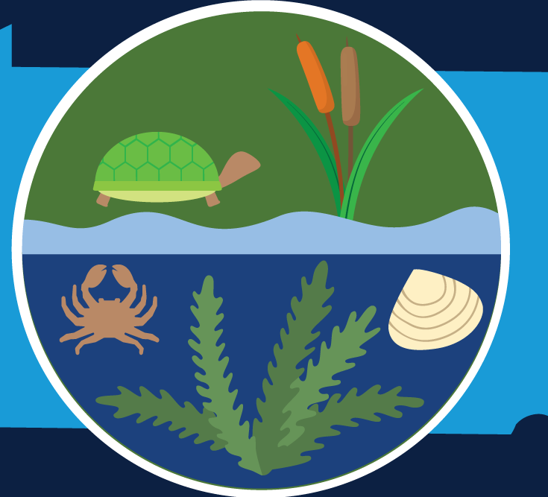
Reporting
PA Seagrant Aquatic Invasive Species App

Slide 48
Picture Links
https://fish.photoshelter.com/image/I0000Yi0pqab4hhk
https://www.rmbel.info/boats-impact-the-littoral-zone/
http://malleedesign.com.au/frogs-ponds-and-native-water-plants/
http://www.northquabbinphotography.com/northern-river-otters/m29dw675d5c37kaq660nm1nzdml5x1
https://www.princetonhydro.com/blog/tag/water-chestnut/
https://www.scottcountymn.gov/1473/Aquatic-Invasive-Plants

